Slide 1
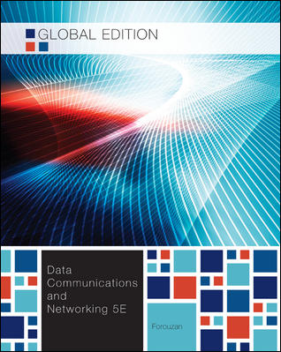
Chapter 12
Media Access Control
(MAC)
School of Computer Science and Engineering
Pusan National University
Jeong Goo Kim

Slide 2
Ch. 12 Outline
    Outline
12.1 Random Access
12.2 Controlled Access
12.3 Channelization

Slide 3
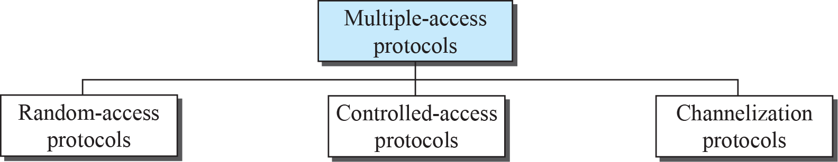
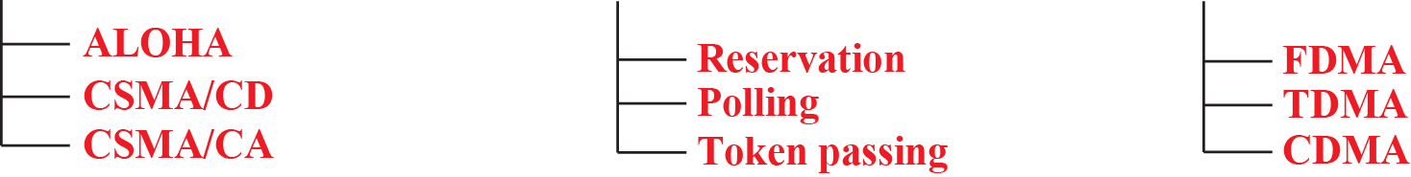
    Ch. 11 Objective
    Objective
Fig. 12.1 Taxonomy of multiple-access protocols

Slide 4
    12.1 Random Access
    12.1 Random Access
In random-access or contention methods, no station is superior to another station and none is assigned control over another.
Random access
  no scheduled time
  transmission is random
Contention
  no rule
  compete with one another to access the medium
    12.1.1 ALOHA
means “additive links on-line Hawaii area”
is the earliest contention method
was designed for radio LAN
can be used any shared medium

Slide 5
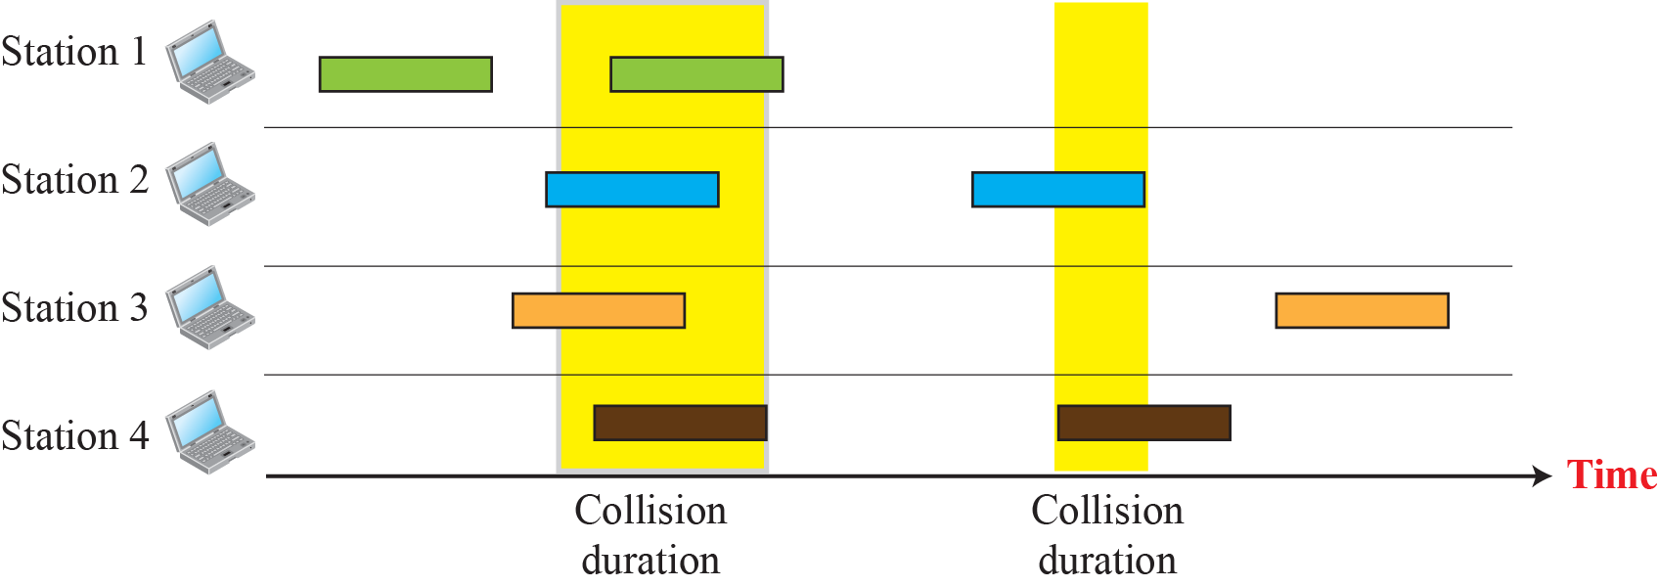
    12.1 Random Access
    Pure ALOHA
very simple
possibility of collision between frames from different stations
  Fig. 12.2 Frames in a pure ALOHA network

Slide 6
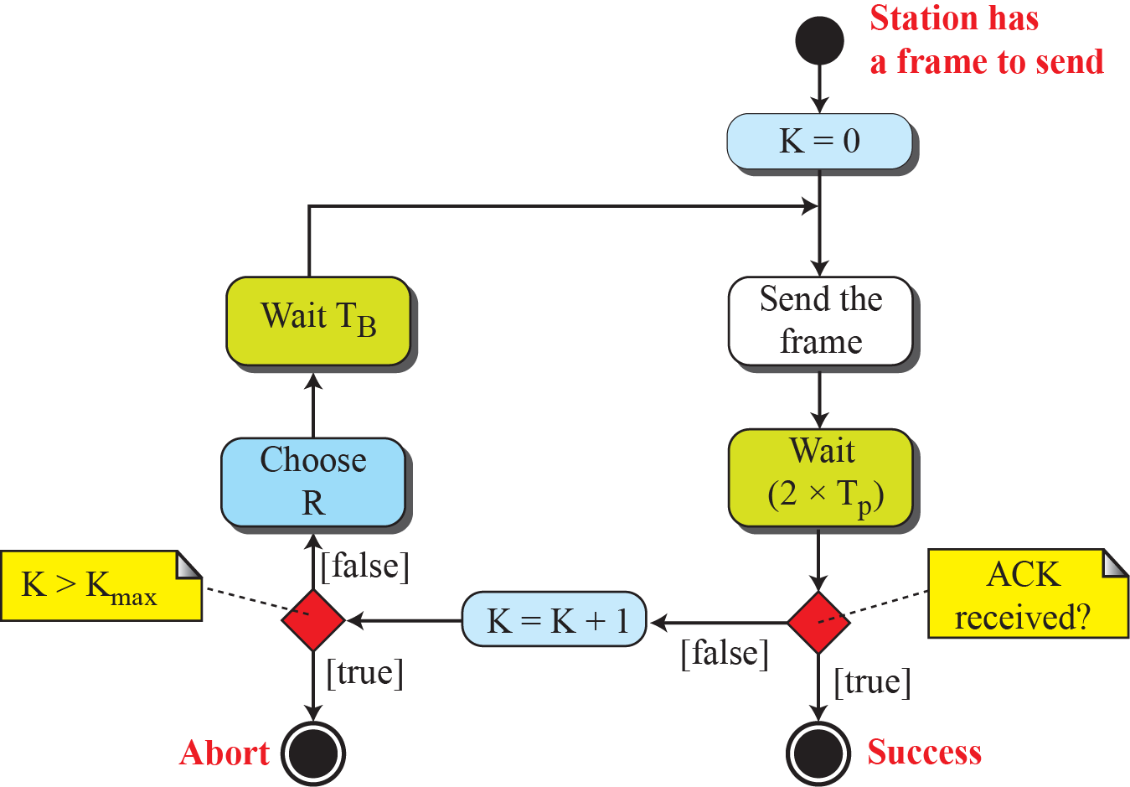
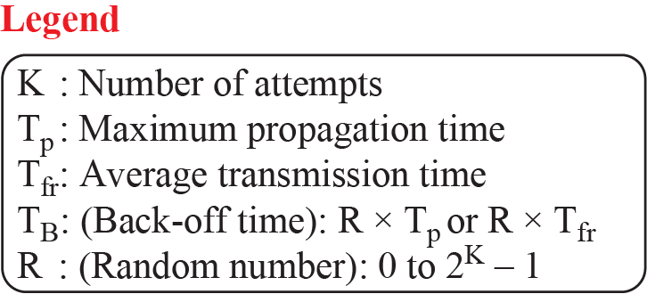
    12.1 Random Access
Procedure
  Fig. 12.3 Procedure for pure ALOHA protocol

Slide 7
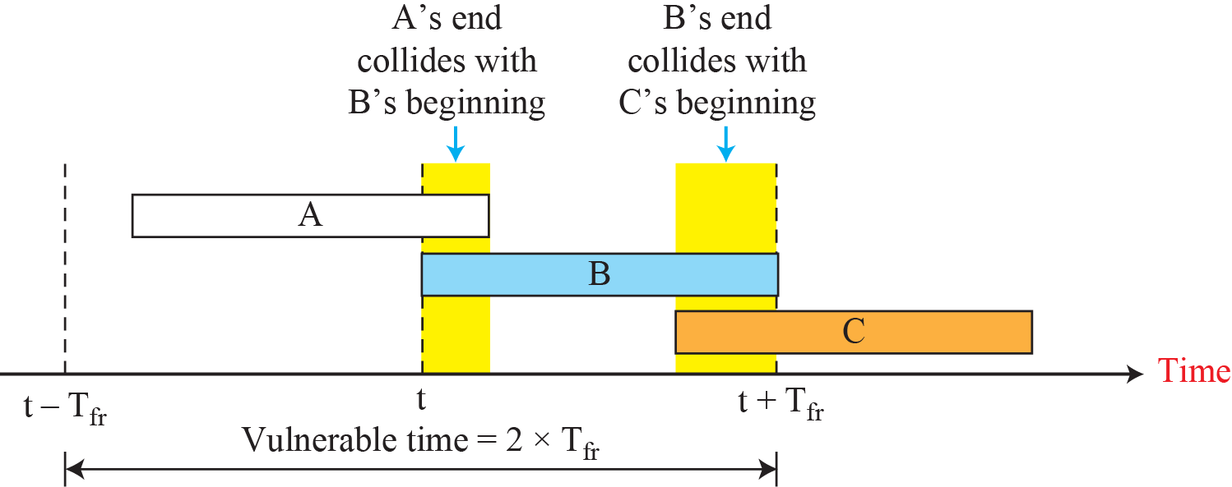
    12.1 Random Access
Ex. 12.1
  The stations on a wireless ALOHA network are a maximum of 600 km apart.
  If we assume that signals propagate at 3 × 10⁸ m/s, we find
  T_{p} = (600 × 10³) / (3 × 10⁸) = 2 ms.
  For K = 2, the range of R is {0, 1, 2, 3}. This means that T_{B} can be 0, 2, 4, or 6 ms, based on the outcome of the random variable R.
Vulnerable time
  the length of time in which ther is a possibility of collision
Fig. 12.3 Vulnerable time for pure ALOHA protocol

Slide 8
    12.1 Random Access
Ex. 12.2
  A pure ALOHA network transmits 200-bit frames on a shared channel of 200 kbps. What is the requirement to make this frame collision-free?
  Solution
  Average frame transmission time T_{fr} is 200 bits/200 kbps or 1 ms. The vulnerable time is 2 × 1 ms = 2 ms. This means no station should send later than 1 ms before this station starts transmission and no station should start sending during the period (1 ms) that this station is sending.
Throughput
  The throughput for pure ALOHA S = G × e^{-2G}
  G : the average number of frames generated by the system during one frame transmission time
  The maximum throughput S_{max} = 1/(2e) = 0.184 when G = 0.5
Ex. 12.3

Slide 9
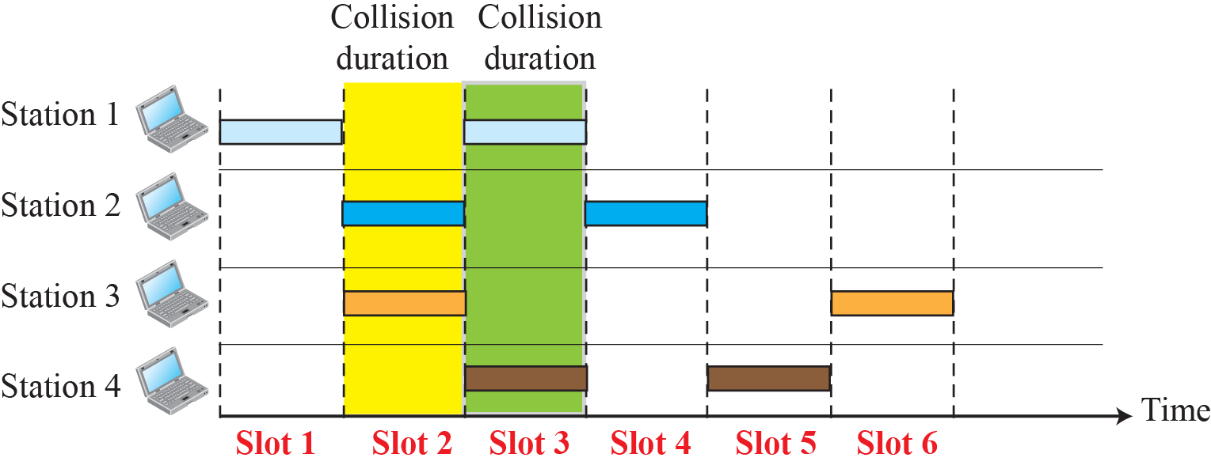
    12.1 Random Access
    Slotted ALOHA
to reduce vulnerable time
  Fig. 12.5 Frames in a slotted ALOHA network

Slide 10
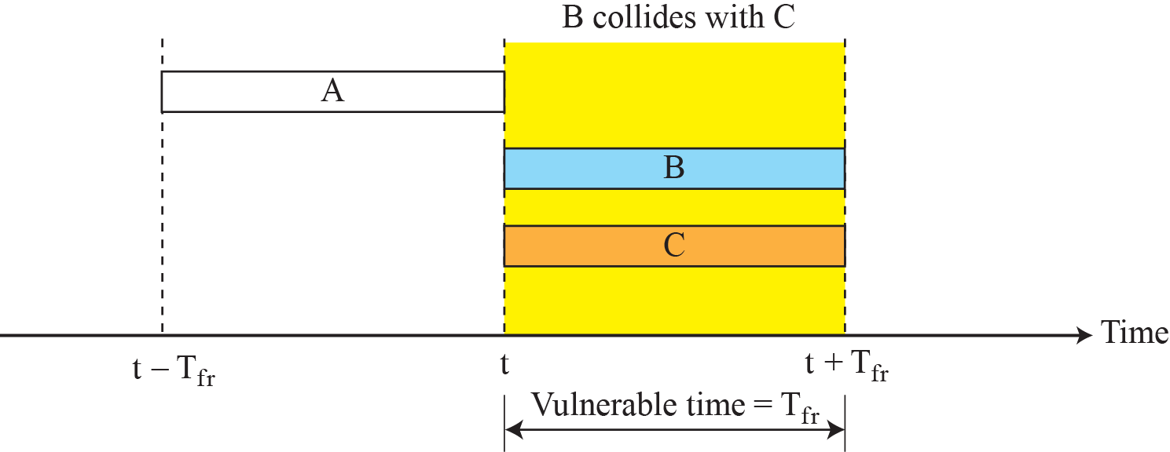
    12.1 Random Access
  Fig. 12.6 Vulnerable time for slotted ALOHA protocol
Throughput
  The throughput forslotted ALOHA S = G × e^{-G}
  The maximum throughput S_{max} = 1/e = 0.368 when G = 1
Ex. 12.4

Slide 11
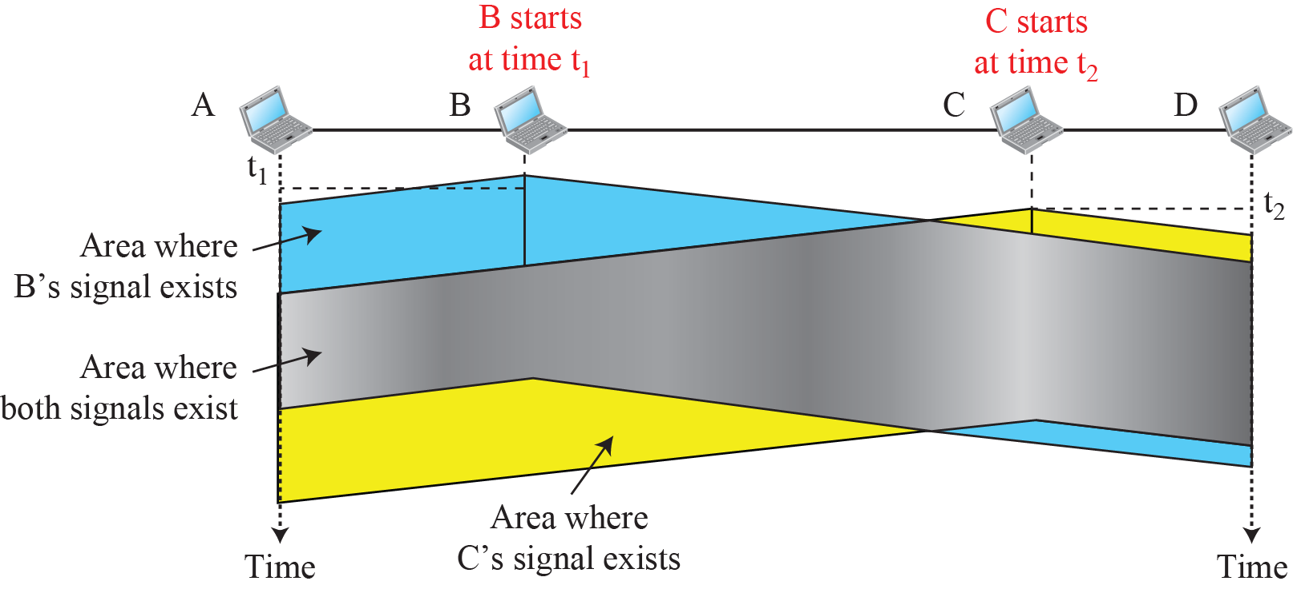
    12.1 Random Access
    12.1.2 CSMA
carrier sense multiple access
to minimize the chance of collision
“sense before transmit,” “listen before talk”
possibility of collision still exists because of propagation delay
Fig. 12.7 Space/time model of a collision in CSMA

Slide 12
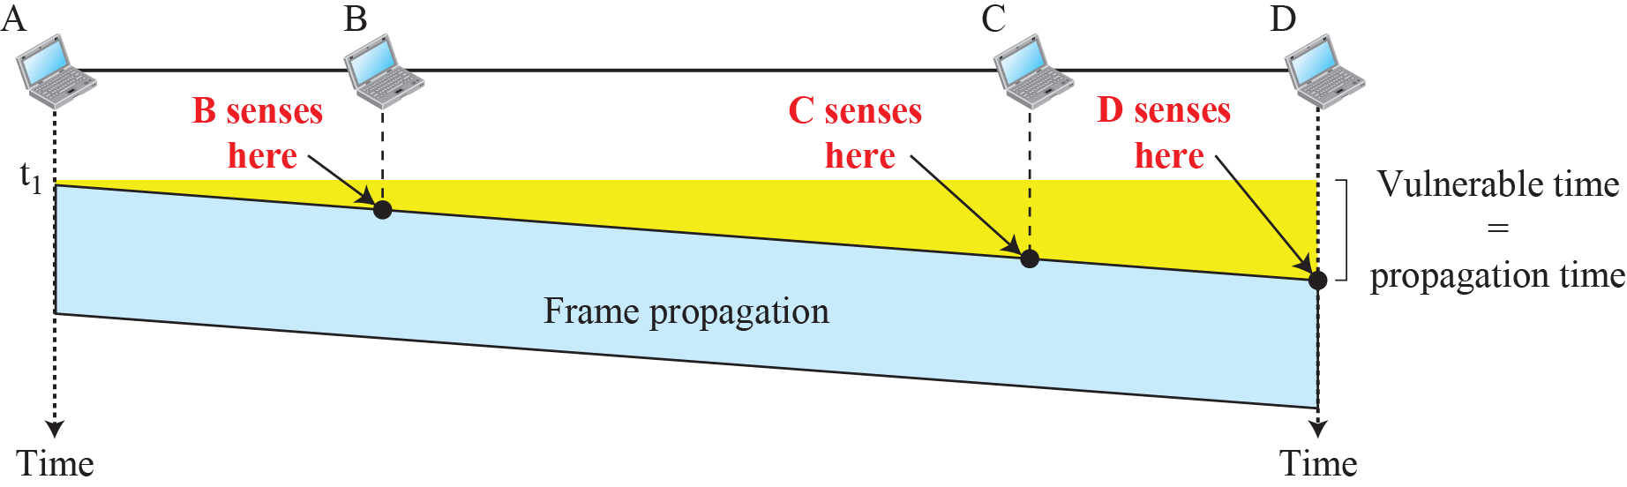
    12.1 Random Access
Vulnerable time
Fig. 12.8 Vulnerable time in CSMA

Slide 13
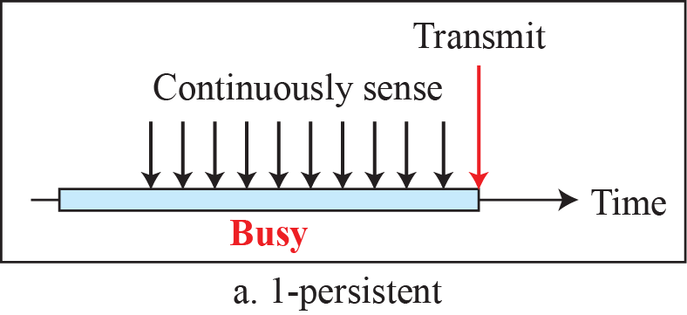
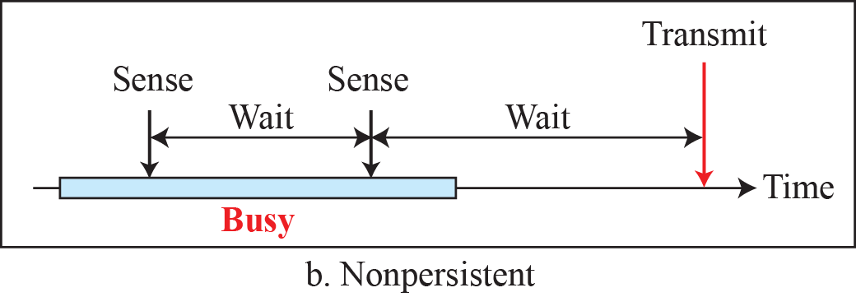
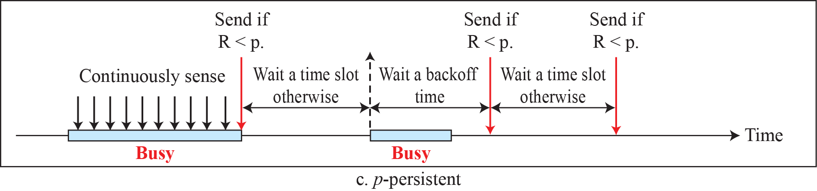
    12.1 Random Access
Persistance Methods
Fig. 12.9 Behavior of three persistence methods

Slide 14
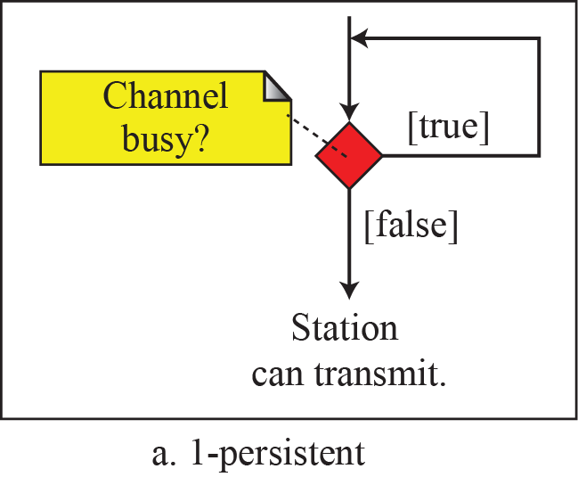
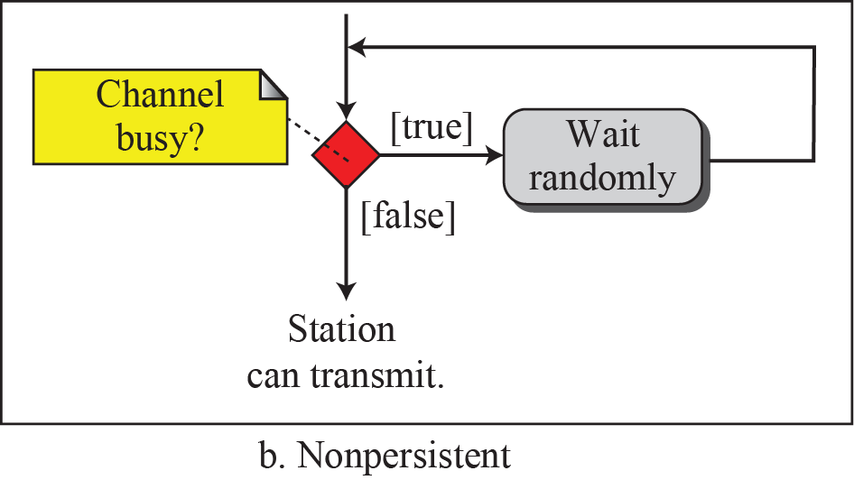
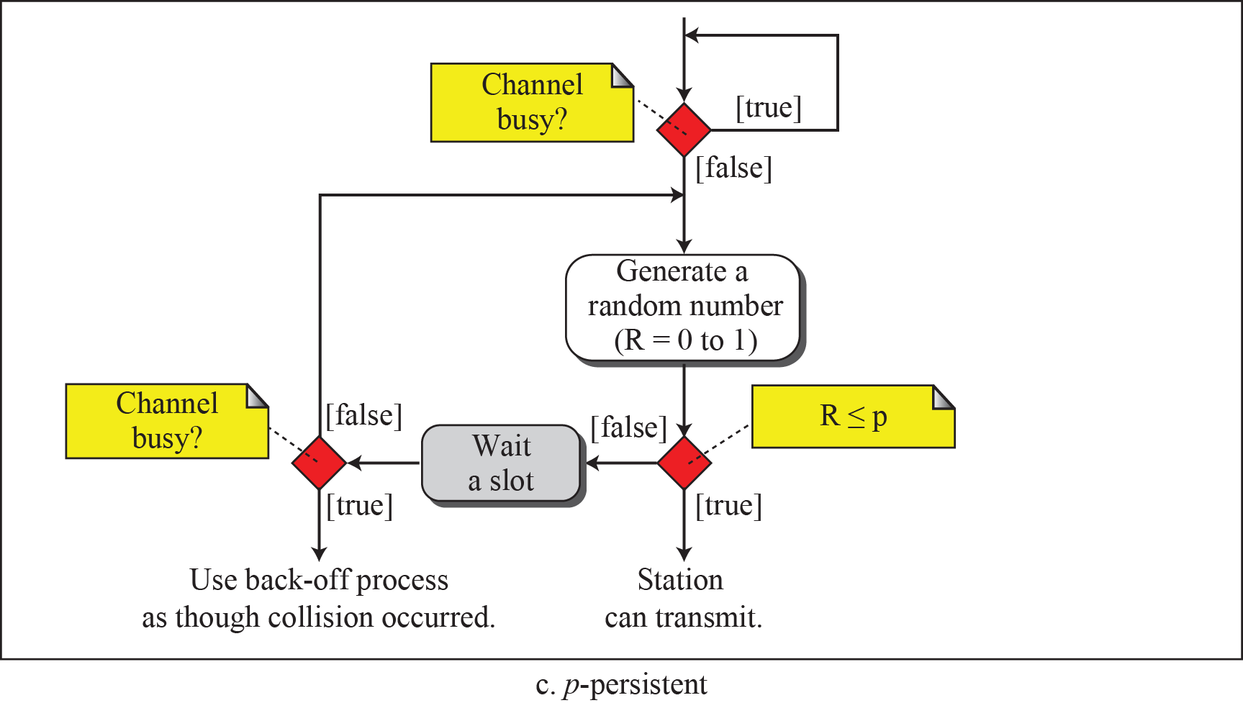
    12.1 Random Access
Fig. 12.10 Flow diagram for three persistence methods

Slide 15
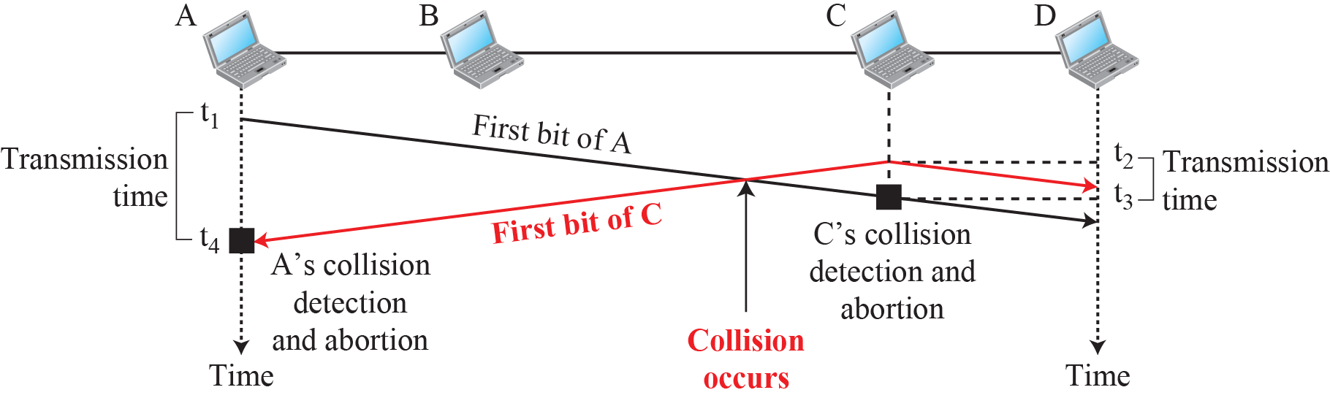
    12.1 Random Access
    12.1.3 CSMA/CD
carrier sense multiple access with collision detection
a station monitors the medium after it sends a frame to see if the transmission was successful.
  If so, the station is finished.
  If, however, there is a collision, the frame is sent again.
Fig. 12.11 Collision of the first bits in CSMA/CD

Slide 16
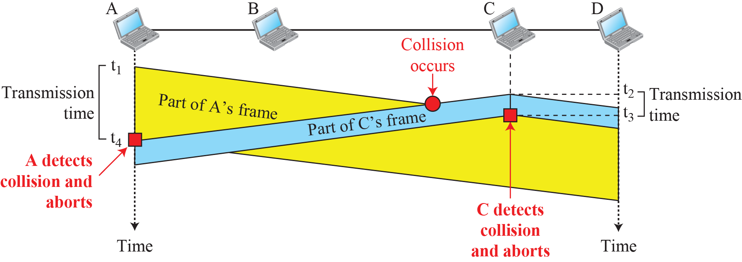
    12.1 Random Access
Fig. 12.12 Collision and abortion ts in CSMA/CD
Minimum Frame Size
  minimum frame transmission time T_{fr} = 2×T_{p}
Ex. 12.5

Slide 17
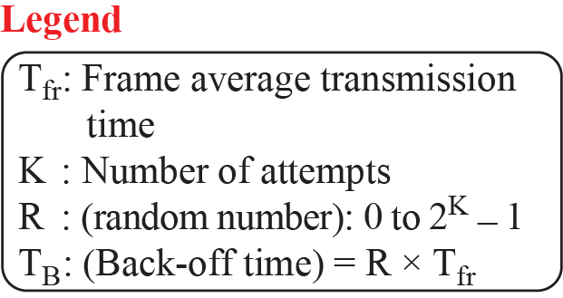
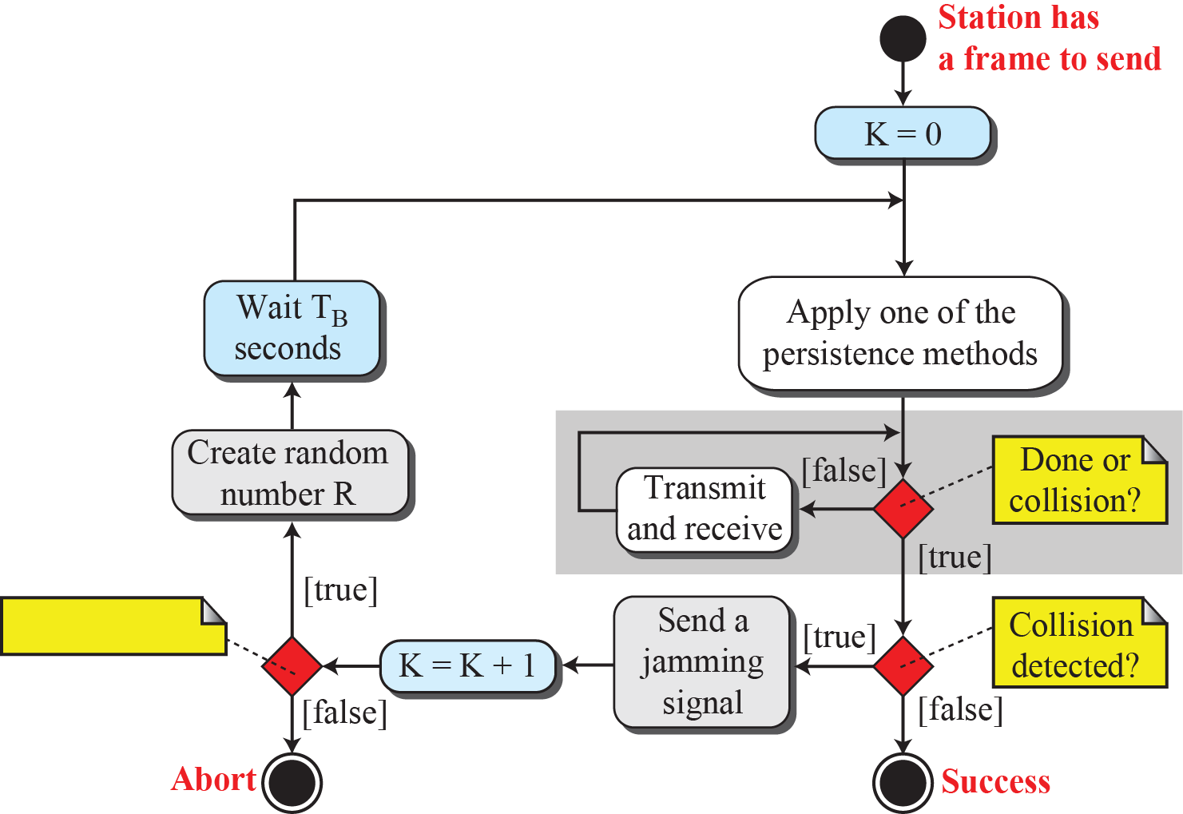
    12.1 Random Access
Procedure
Fig. 12.13 Flow diagram for the CSMA/CD

Slide 18
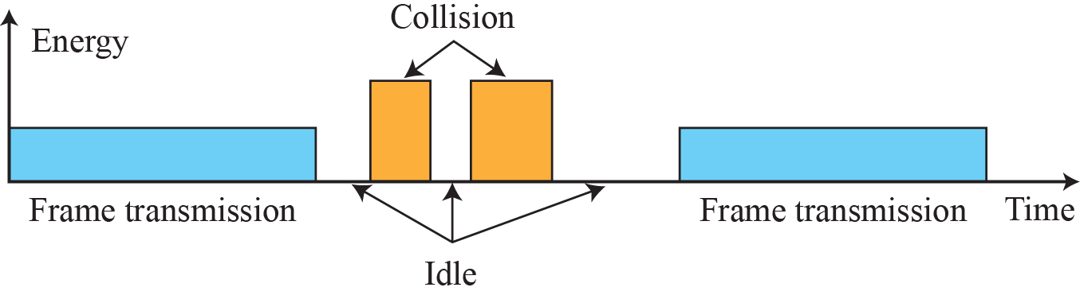
    12.1 Random Access
Energy Level
Fig. 12.14 Flow diagram for the CSMA/CD
Throughput
  greater than that of pure or slotted ALOHA
Traditional Ethernet
  Ethernet with 10 Mbps

Slide 19
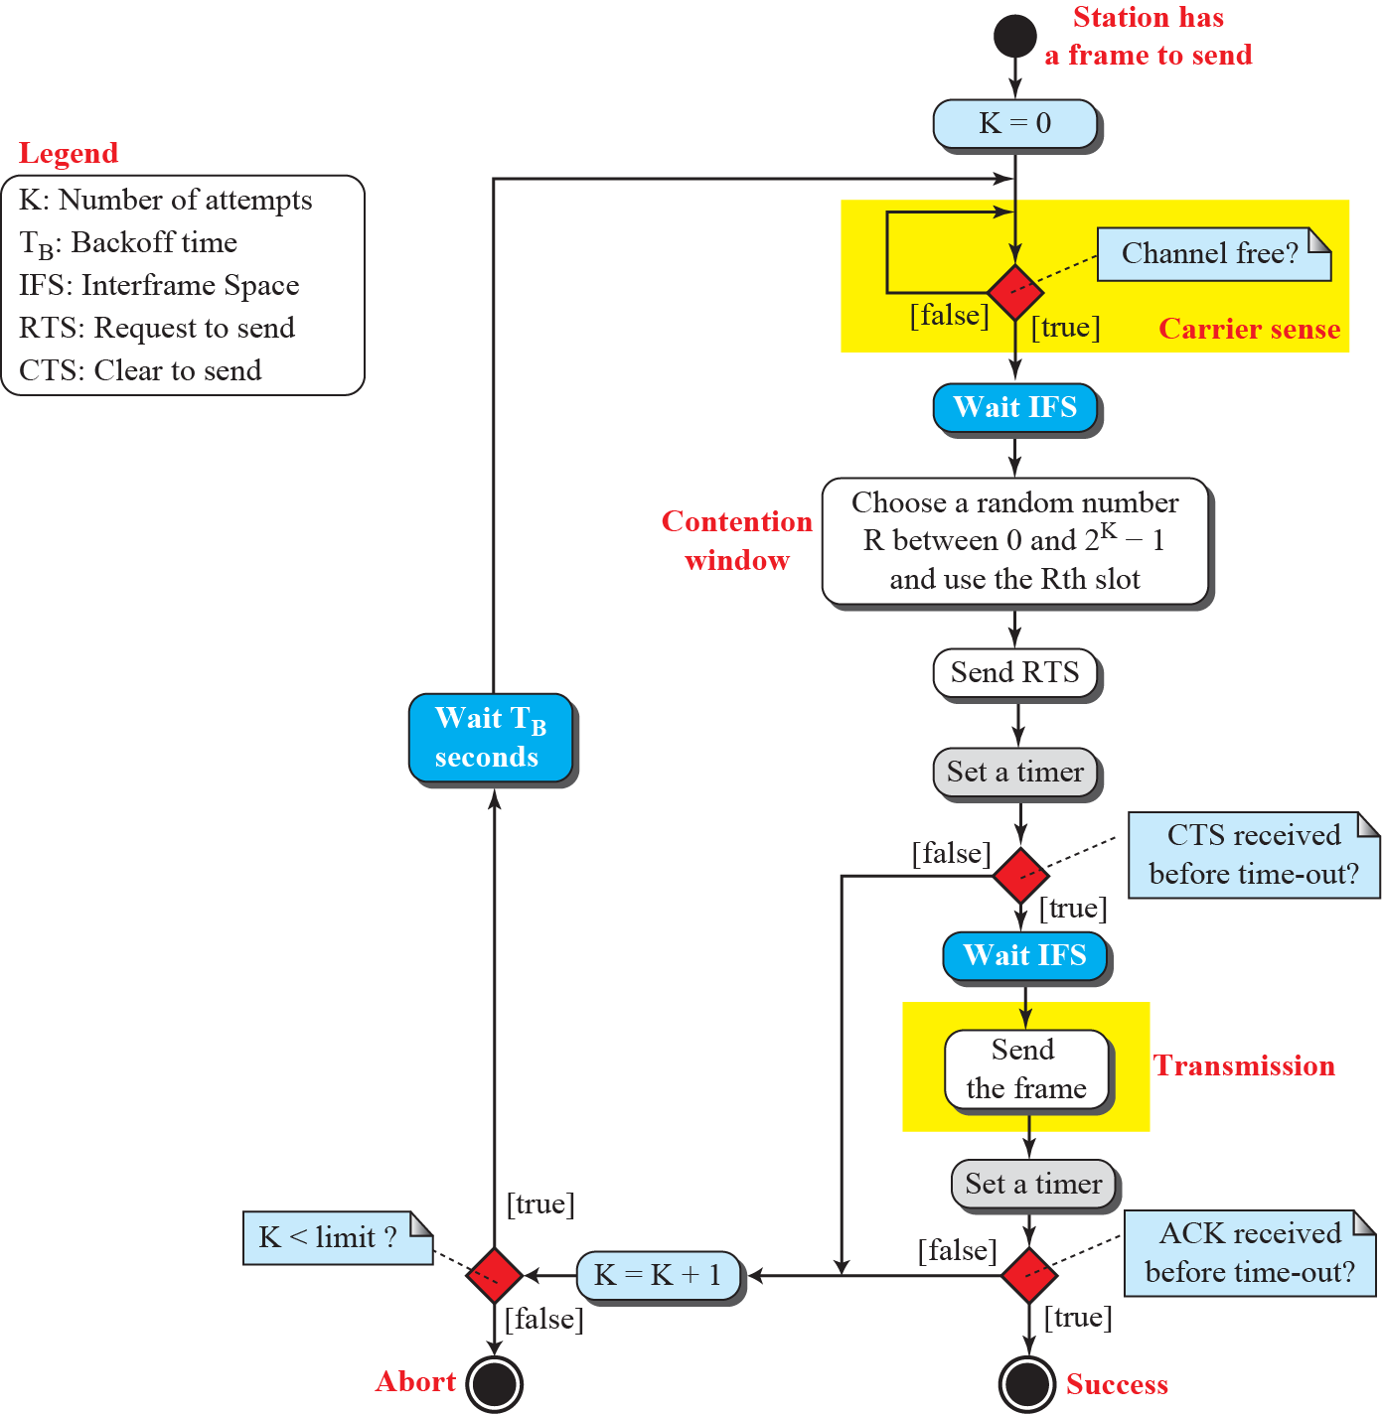
    12.1 Random Access
    12.1.4 CSMA/CA
CSMA with
collision avoidance
Fig. 2.15: Flow diagram for
CSMA/CA

Slide 20
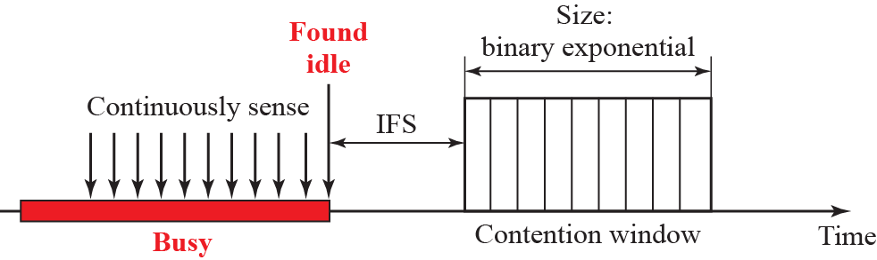
    12.1 Random Access
Interframe Space (IFS)
  to avoid collision
Contention window
Fig. 2.16: Contention window

Slide 21
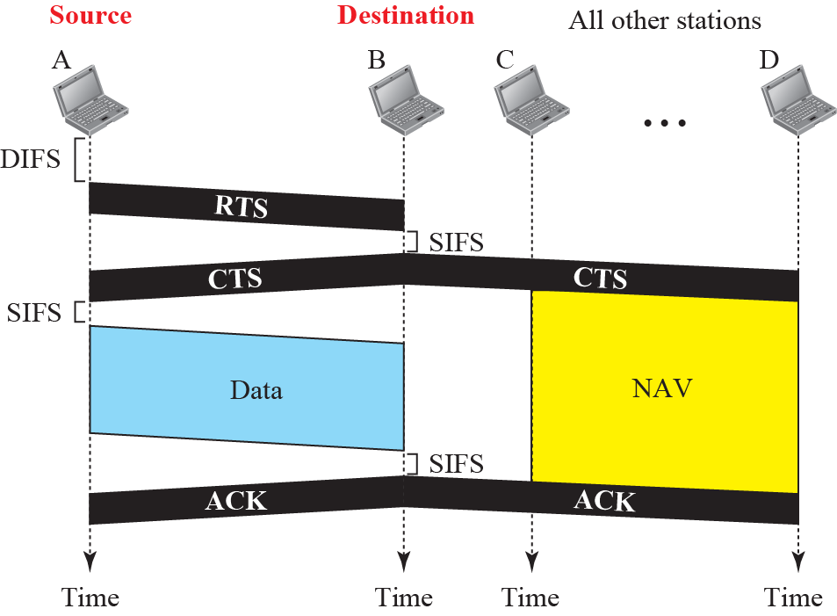
    12.1 Random Access
Network Allocation Vector
Fig. 2.17 CSMA/CA and NAV

Slide 22
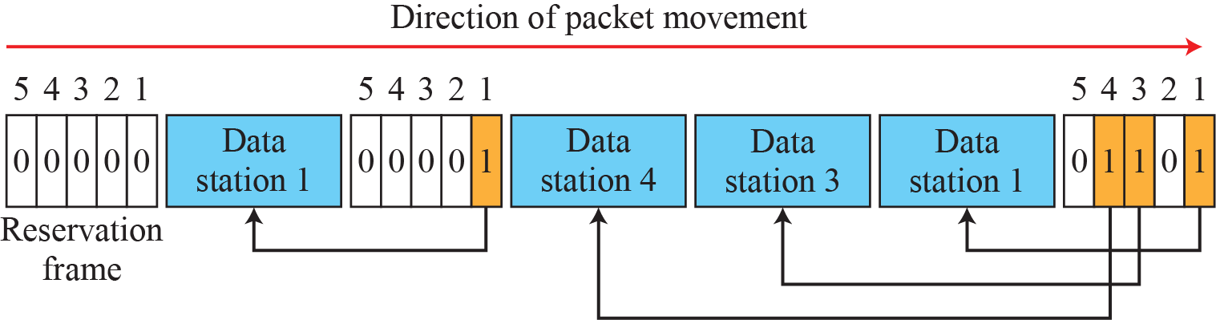
    12.2 Controlled Access
    12.2 Controlled Access
the stations consult one another to find which station has the right to send.
A station cannot send unless it has been authorized by other stations.
12.2.1 Reservation
Fig. 12.18 Reservation access method

Slide 23
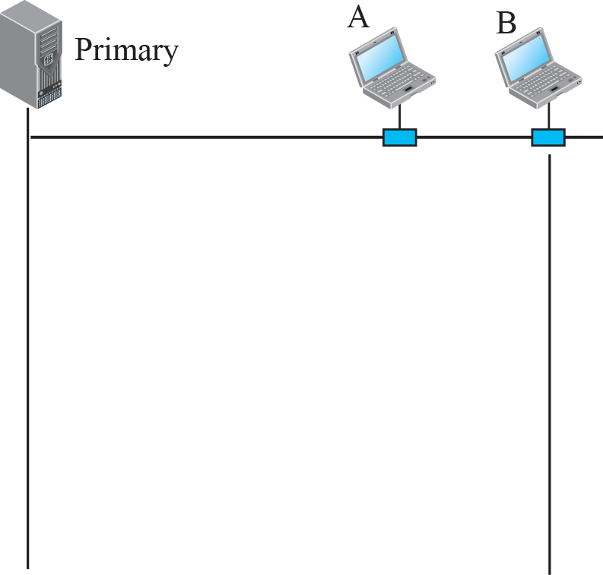
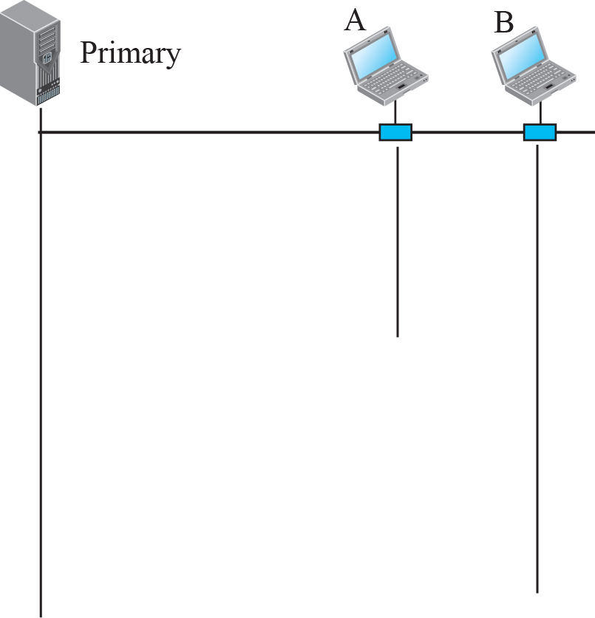







    12.2 Controlled Access
12.2.1 Polling
primary station and secondary stations
all data exchanges must be made through the primary device
primary device controls the link
uses SEL and POLL to prevent collisions
if the primary station fails, the system goes down

Slide 24
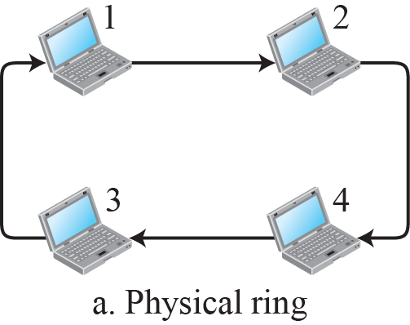
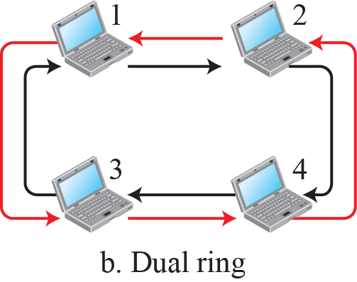
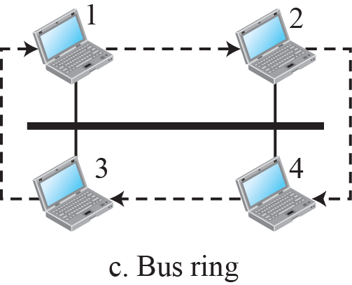
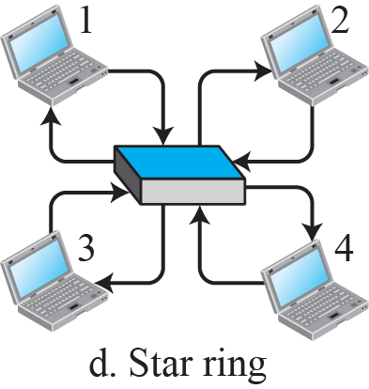
    12.2 Controlled Access
12.2.3 Token Passing
the stations in a network are organized in a logical ring
there is a predecessor and a successor
the possession of the token gives the station the right to access the channel and send its data.

Slide 25
    12.3 Channelization
    12.3 Channelization
(or channel partition) is a multiple-access method in which the available bandwidth of a link is shared in time, frequency, or through code, among different stations.
12.3.1 FDMA
the available bandwidth is divided into frequency bands.
Each station is allocated a band to send its data.
to prevent station interferences, the allocated bands are separated by guard bands

Slide 26
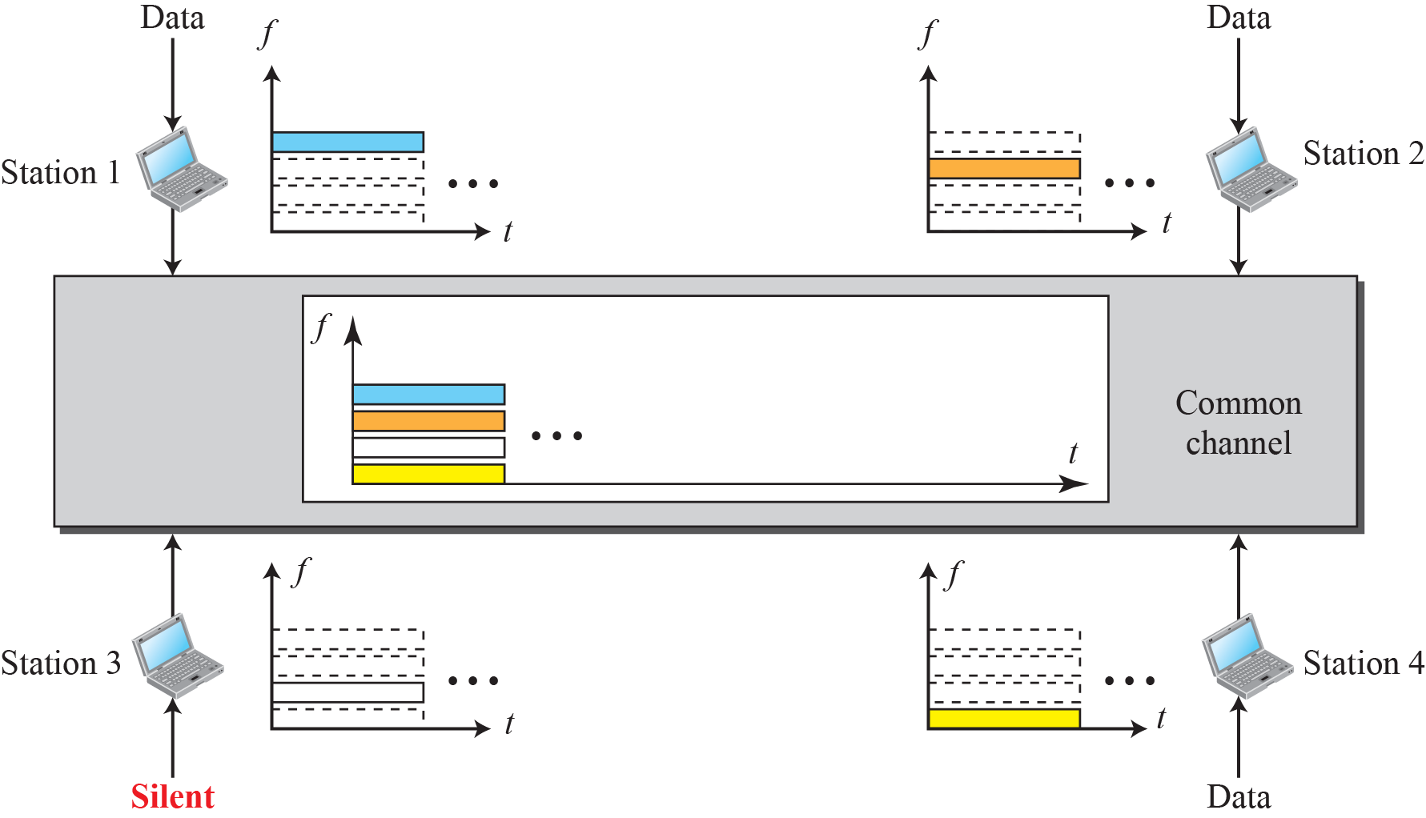
    12.3 Channelization
Fig. 12.21 Frequency-division multiple access (FDMA)

Slide 27
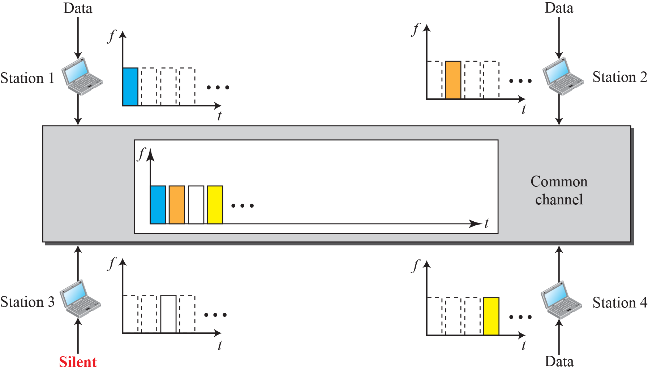
    12.3 Channelization
12.3.2 TDMA
the stations share the bandwidth of the channel in time.

Slide 28
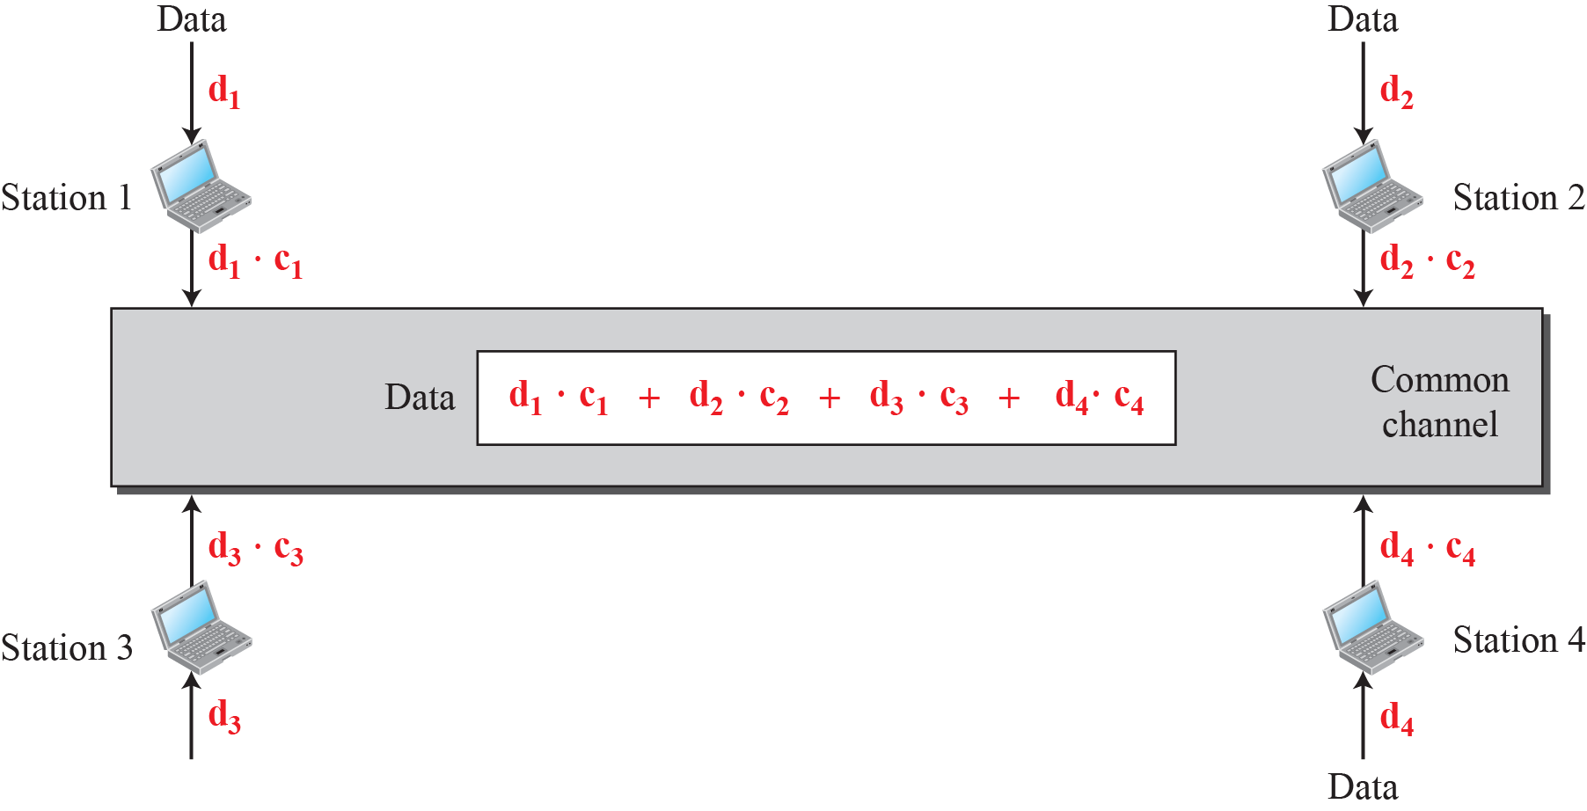
    12.3 Channelization
12.3.3 CDMA
all stations can send data simultaneously
Fig. 12.23 Simple idea of communication with code

Slide 29
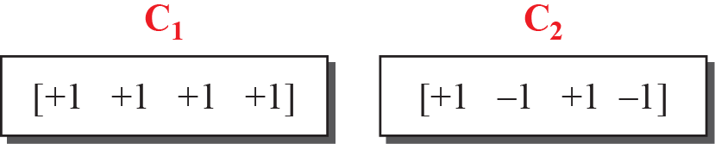
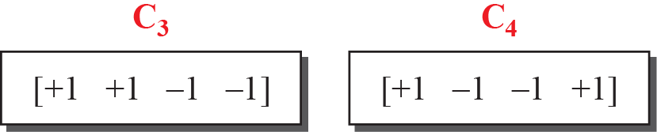
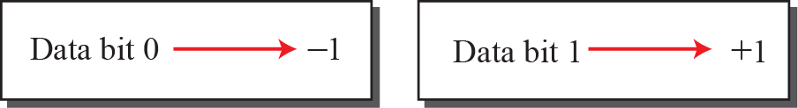
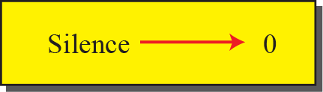
    12.3 Channelization
Fig. 12.24 Chip sequence
Fig. 12.25 Data representation in CDMA
multiply
  2∙[+1 +1 -1 -1] = [+2 +2 -2 -2]
inner product
  [+1 +1 -1 -1]∙[+1 +1 -1 -1] = 1+1+1+1+1=4
  [+1 +1 -1 -1]∙[+1 +1 +1 +1] = 1+1+1-1-1=0
adding
  [+1 +1 -1 -1]+[+1 +1 +1 +1] = [+2 +2 0 0]

Slide 30
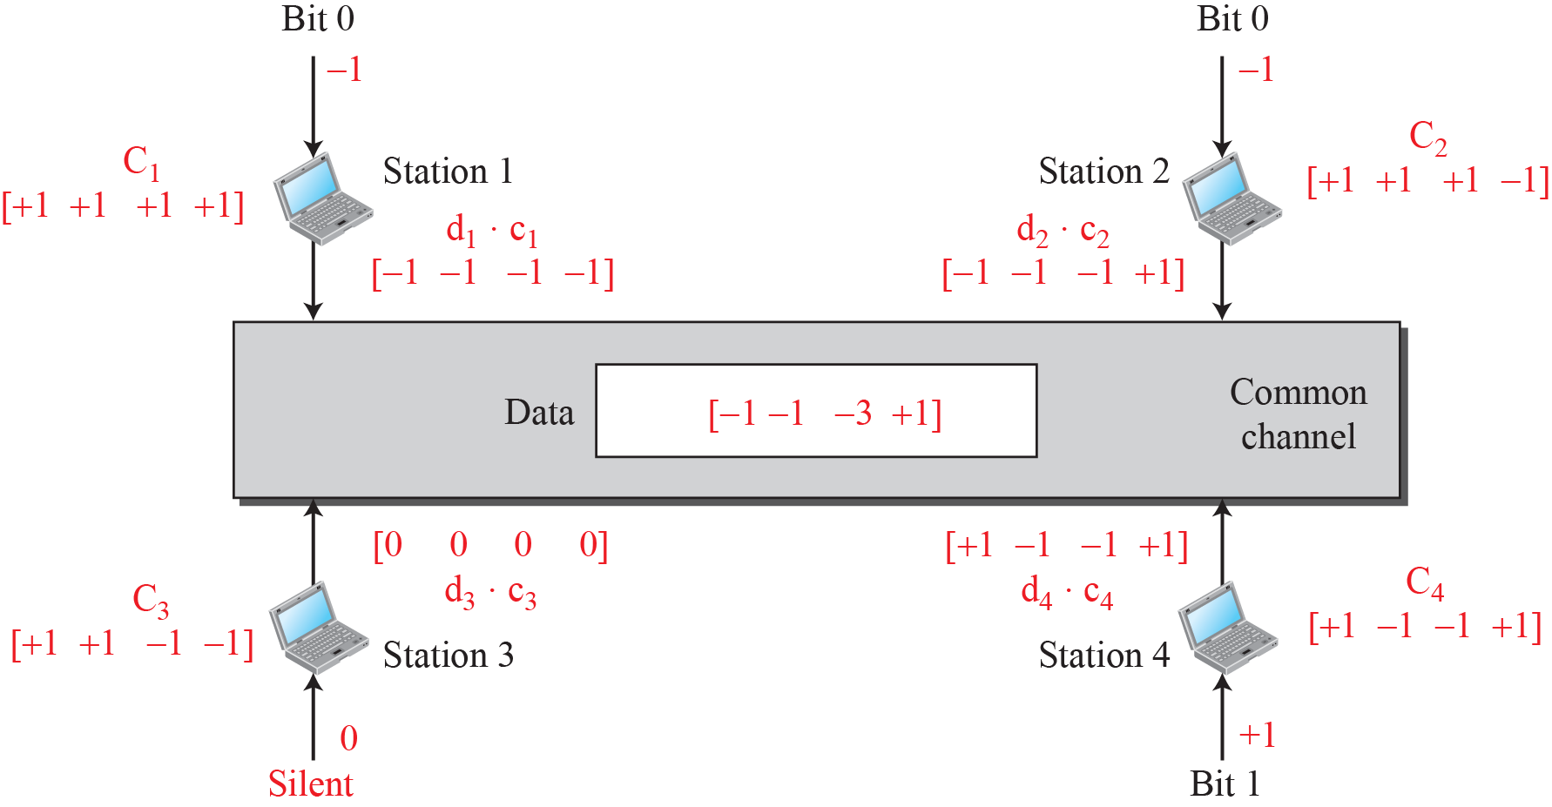
    12.3 Channelization
Fig. 12.26 Sharing channel in CDMA

Slide 31
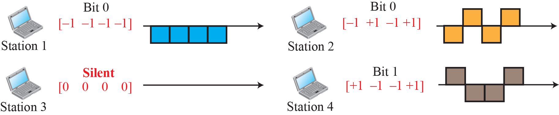
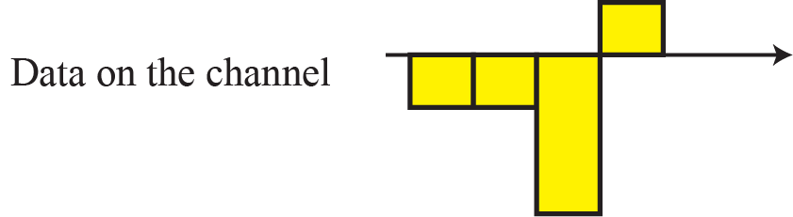
    12.3 Channelization
Fig. 12.27 Digital signal created by four stations in CDMA

Slide 32
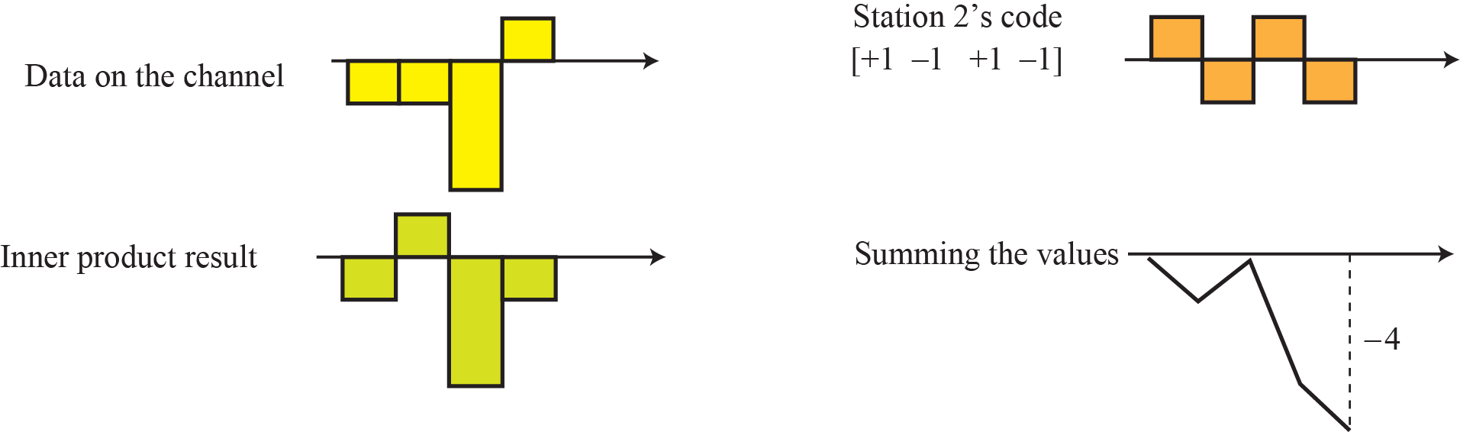
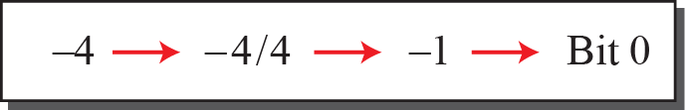
    12.3 Channelization
Fig. 12.28 Decoding of the composite signal for one in CDMA

Slide 33
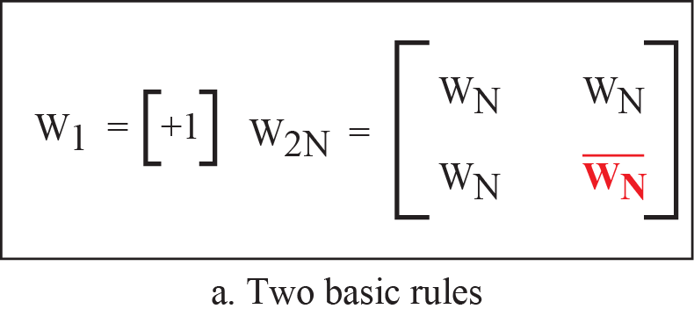
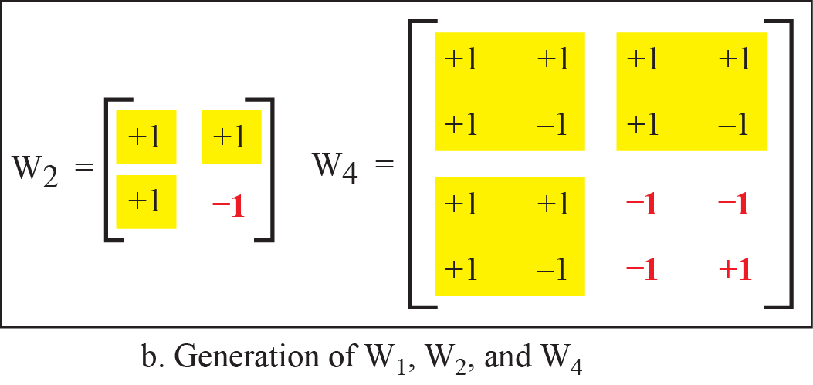
    12.3 Channelization
Fig. 12.29 General rules and examples of creating Walsh tables

Slide 34
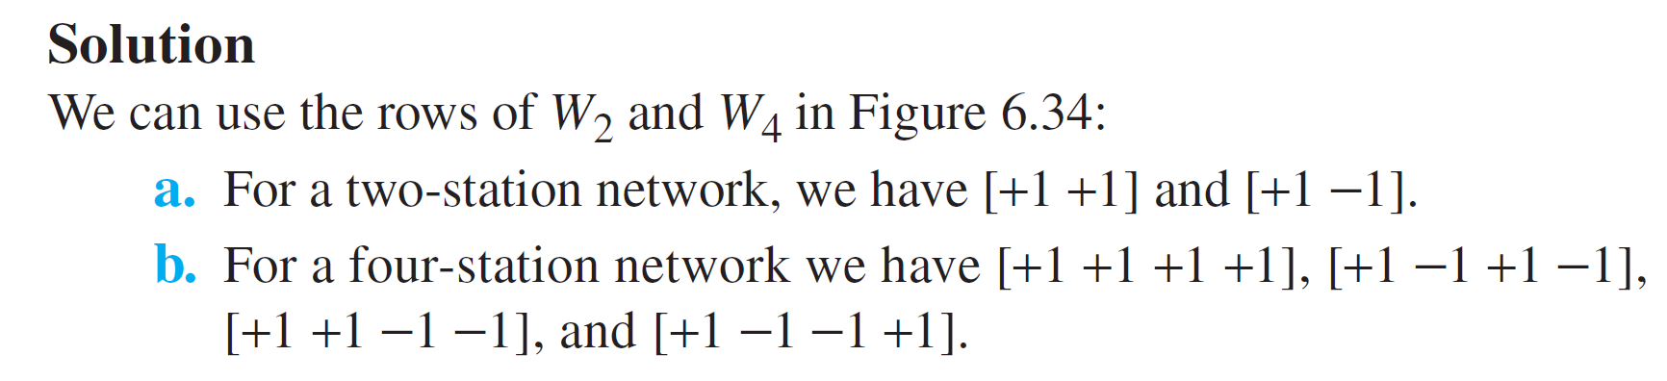
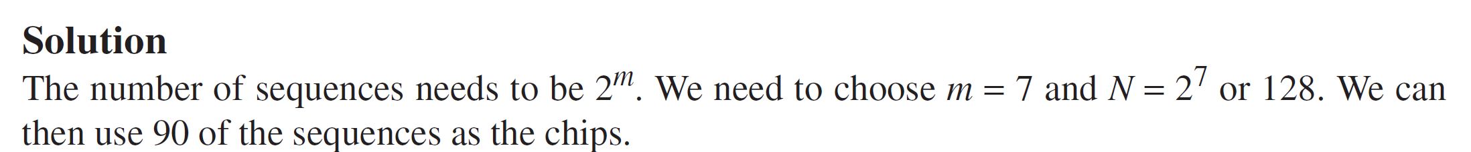
    12.3 Channelization
Ex. 12.6
Find the chips for a network with
a. Two stations
b. Four stations
Ex. 12.7
What is the number of sequences if we have 90 stations in our network?

Slide 35
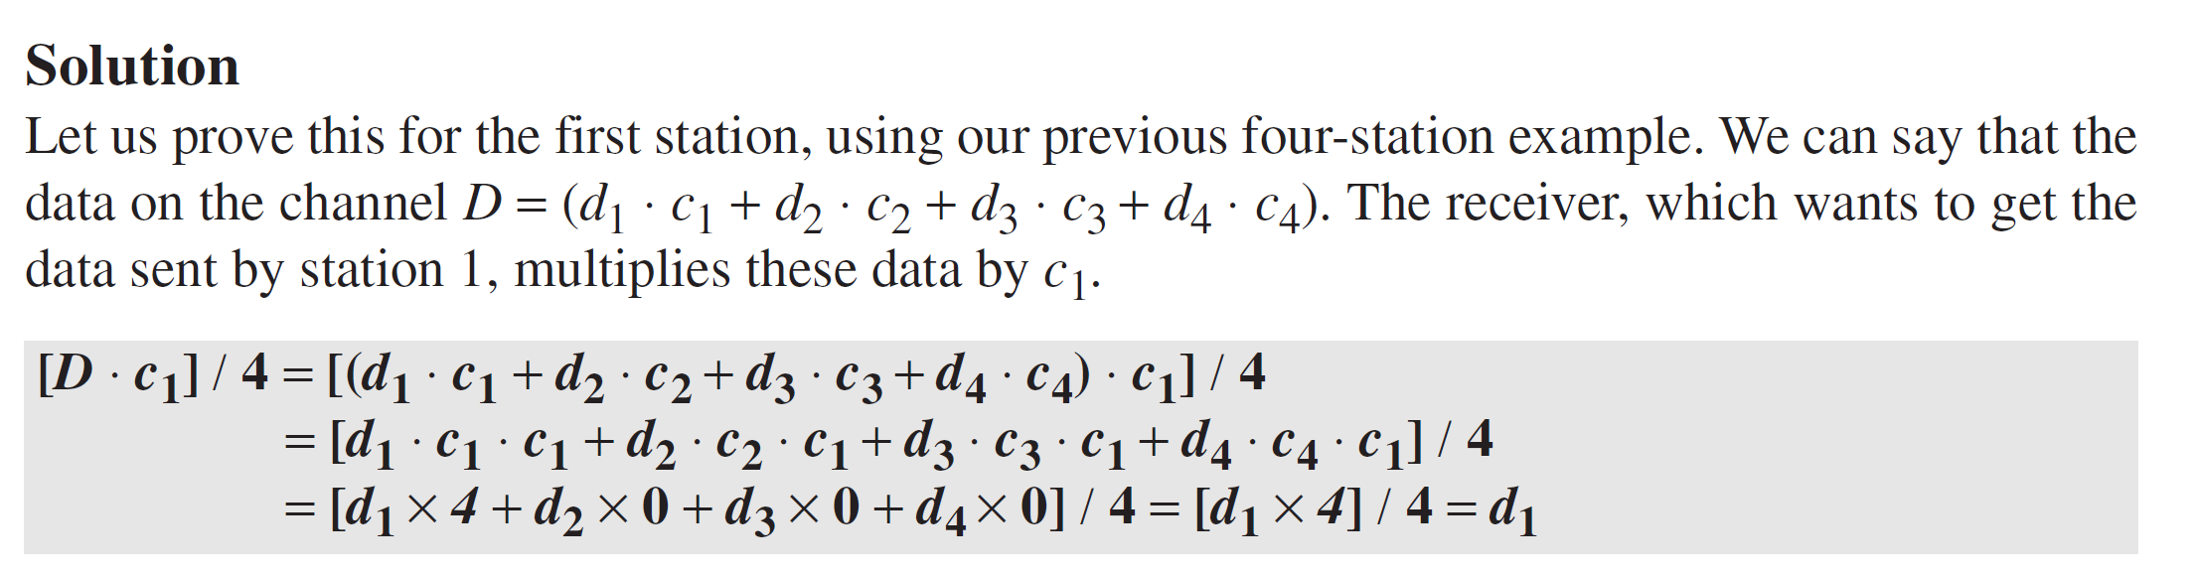
    12.3 Channelization
Ex. 12.8
Prove that a receiving station can get the data sent by a specific sender if it
multiplies the entire data on the channel by the sender’s chip code and then
divides it by the number of stations.

Slide 36
    Homework
Homework
Solve Problems P12-1, P12-3, P12-10, P12-15, P12-25
Read textbook pp. 361-383
Next Lecture
Chapter 13. wired LANs: Ethernet

